Slide 1
Qualities in Intelligent Systems
Part-II
In this assignment, we will build a Docker container to perform batch serving of a ML model.

Slide 2
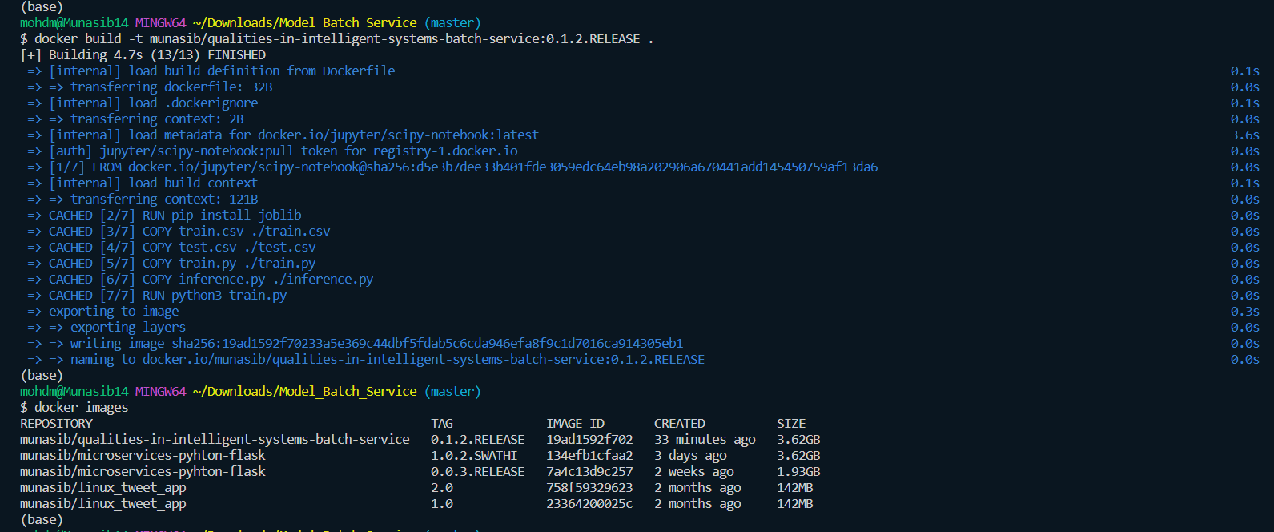

Slide 3
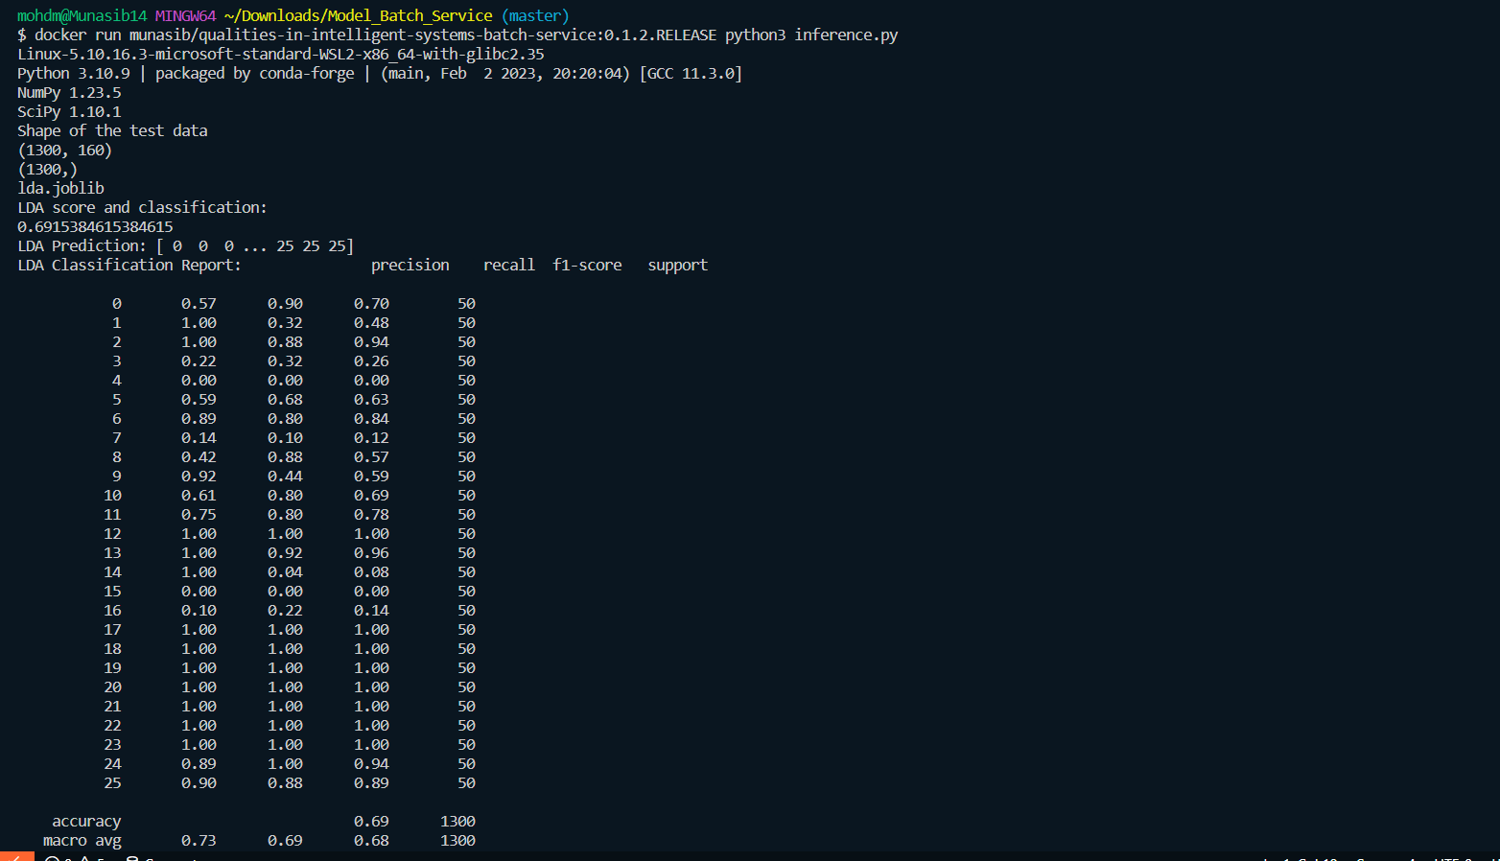

Slide 4
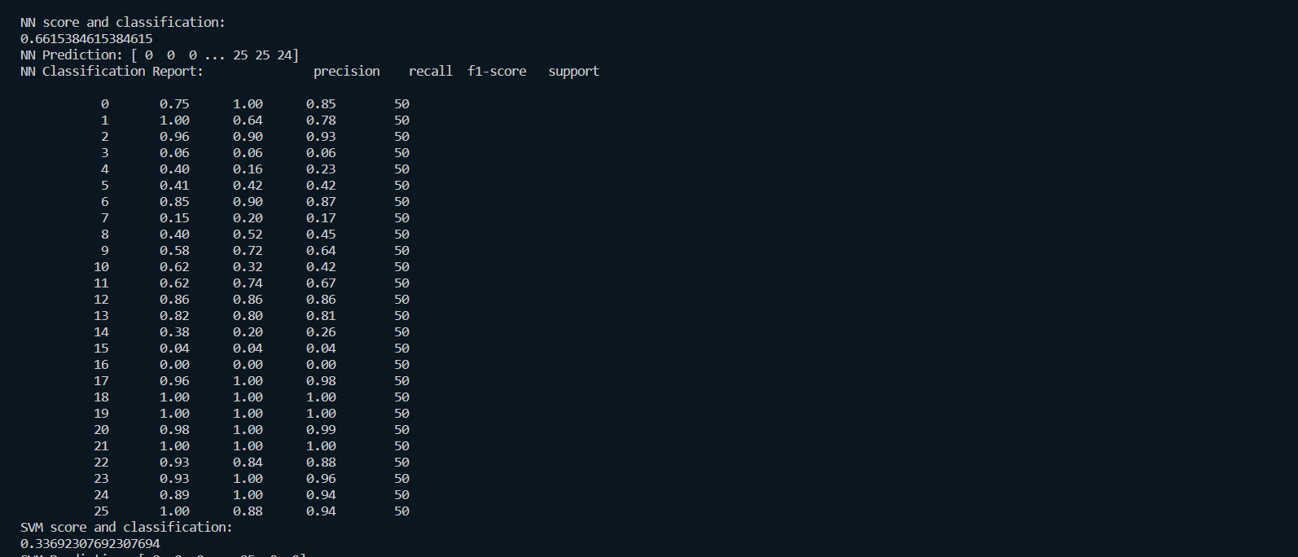

Slide 5
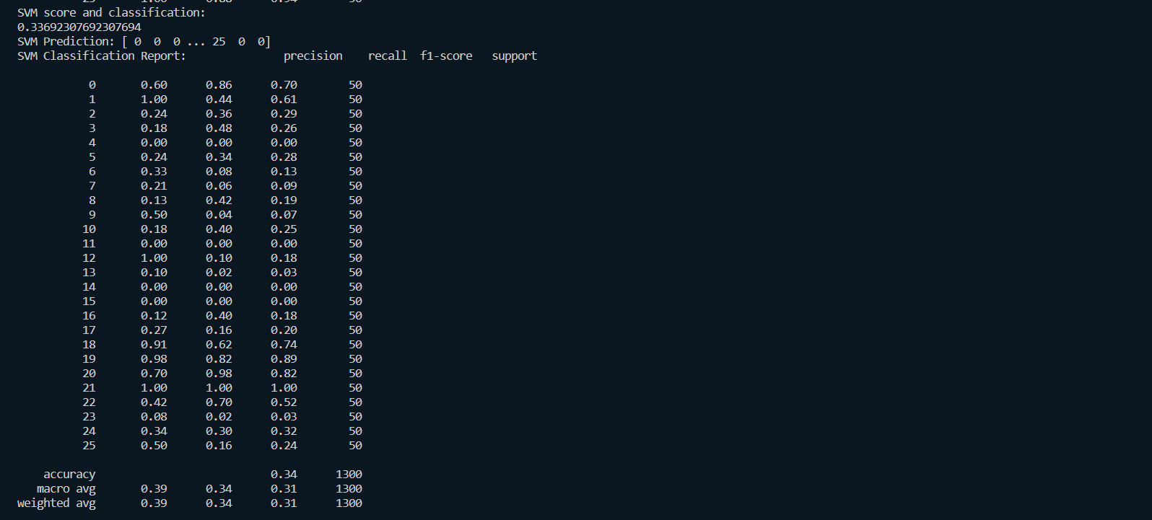

Slide 6
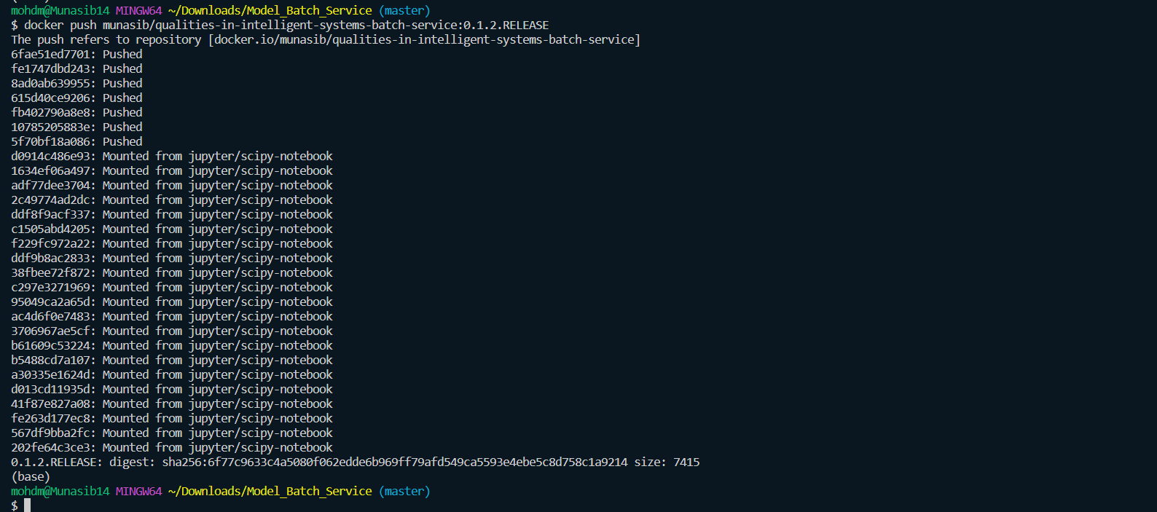

Slide 7
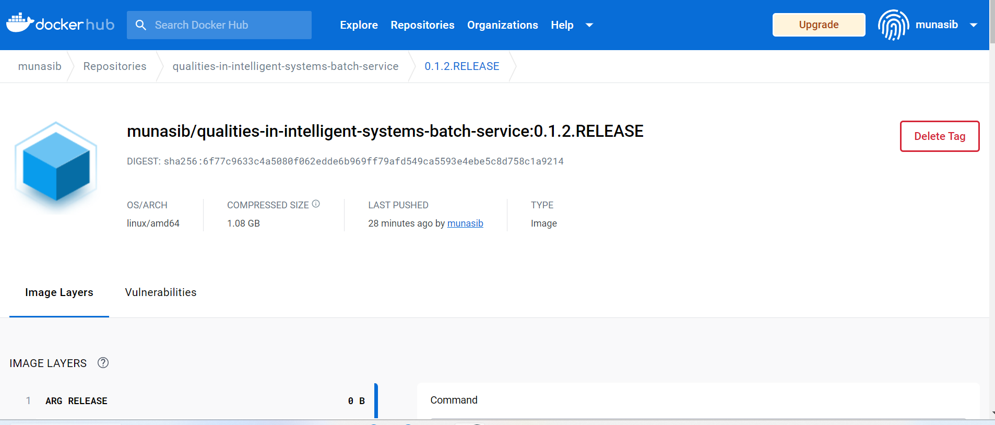
https://hub.docker.com/layers/munasib/qualities-in-intelligent-systems-batch-service/0.1.2.RELEASE/images/sha256-6f77c9633c4a5080f062edde6b969ff79afd549ca5593e4ebe5c8d758c1a9214?context=repo

